Slide 2
Edible Oil Industry
Technology Challenges and Solutions
2007 ICFMCE
Dubai
November 25, 2017
Bent Sarup

Slide 3
Outline
Industry overview and trends
Technology introduction
Examples of new developments
Summary

Slide 4
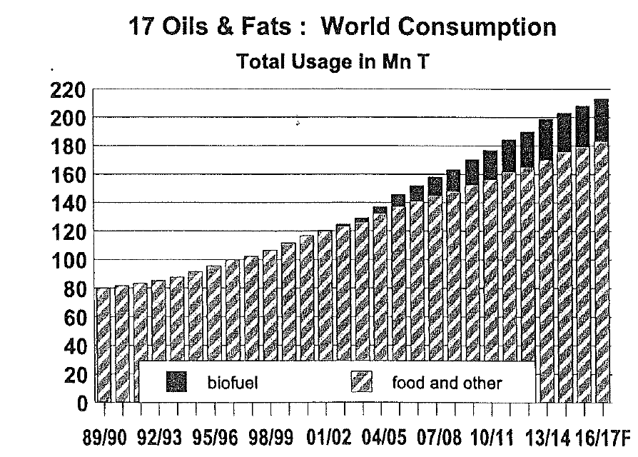
Oil demand has been on a steady growth path
Ref. Oil World, Sep 23, 2016

Slide 5
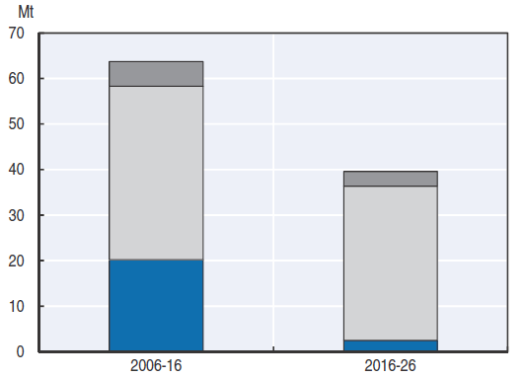
Biofuel demand foreseen to reduce
Reference: OECD-FAO AGRICULTURALOUTLOOK (2017)

Slide 6
Consumption per Capita CAGR 2010-2015 = 3.5%
The most developed countries consume about twice the amount of oil per capita (but stagnating) as an average developing country (growing)
Reference:
Annex A, OECD-FAO AGRICULTURALOUTLOOK (2015)

Slide 7
Edible Oil Industry Overview
EXTRACTION
Refining
Liquid edible oils
Crude Oil
- palm
- soybean
- rapeseed
- sunflower
- corn
- coconut
- palm kernel
- cottonseed
- groundnut
- ricebran
- tallow
- fish
Fat modification
Specialty fats
Fatty acids
Fat splitting,
distillation, ..
Oleochemicals
Glycerin
Pretreatment +
transesterification
Biodiesel

Slide 8
Edible oil industry drivers
Solid structural growth (food demand)
Healthier foods (nutritional value, safety)
Minimize losses and utilize byproducts
Energy efficiency
Sustainability
www.alfalaval.com

Slide 9
Edible Oil Refining

Slide 10
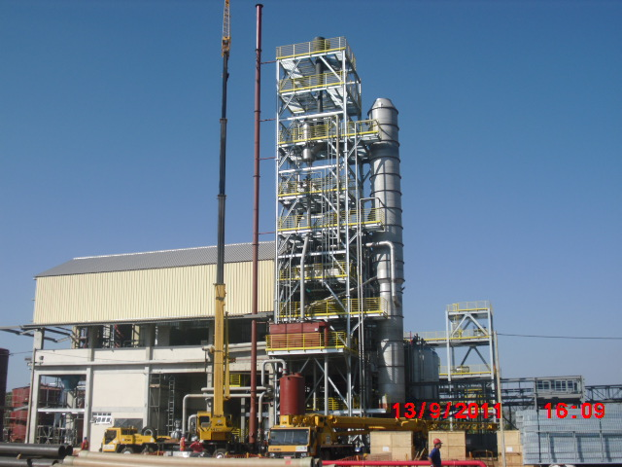
R&D in process system development
Performance
Time
Customer
Process solution supplier
Universities
Sub-suppliers
Funding agencies

Slide 11
Example 1. University collaboration
Modelling of lipid systems and application example for micronutrient recovery

Slide 12
Challenges in lipid modelling
Experimental measurements for obtaining properties of lipids of interest are time consuming, expensive, sometimes may not even be feasible.
Issues related to accuracy and reliability of the available data and property prediction models need particular attention.
Design & analysis of lipids processes require:
databases containing necessary property information
reliable and consistent property prediction models
validation of data & property models using reliable plant data

Slide 13
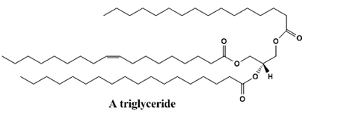
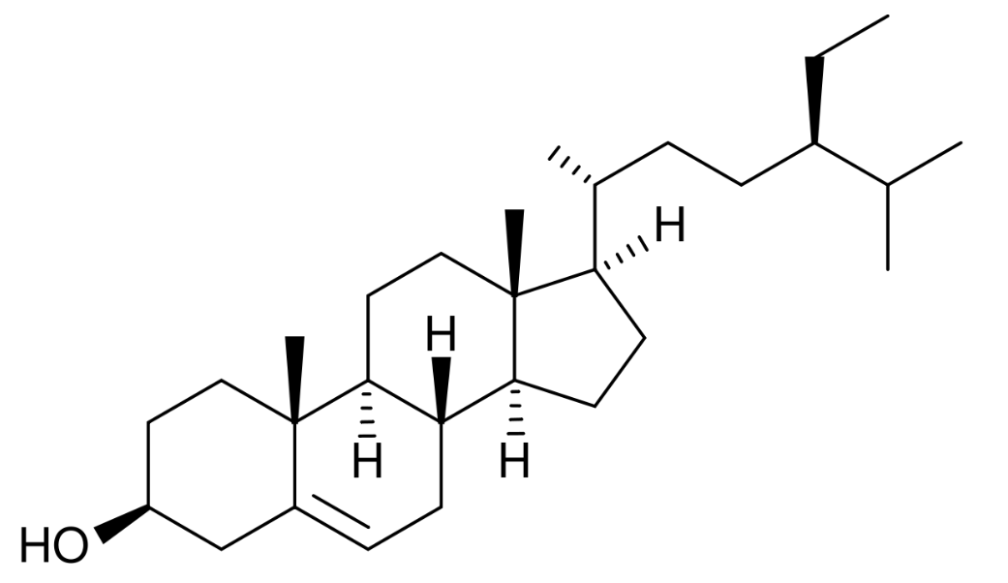
Some lipid molecular structures
Β-tocopherol
A triglyceride
Β-sitosterol
A free fatty acid
A phospholipid
http://upload.wikimedia.org/wikipedia/commons

Slide 14
Property prediction by GC methods
For Primary Properties of Lipids
Marrero and Gani group-contribution (GC) Method ¹
The function f (X) is a function contains the target property X.
Atom Connectivity Index Method ²
(is used to create/predict missing group contributions)
Quantification of confidence intervals ³
(to assess reliability of the predictions)
For Temperature Dependent Properties of Lipids
Ceriani et al. (2012) GC Method ⁴
(for prediction of vapor pressure and heat of vaporization
of lipids)
REFERENCES:
¹ J. Marrero, and R. Gani, Fluid Phase Equilibria, (2001), 183-208.
² R. Gani et al. Industrial and Engineering Chemistry Research, (2005), 7262-7269.
³ A. Hukkerikar et al., Fluid Phase Equilibria, 321 (2012) 25-43.
⁴ R. Ceriani, R. Gani, Y. A. Liu, Fluid Phase Equilibria, (2012), 53-59.

Slide 15
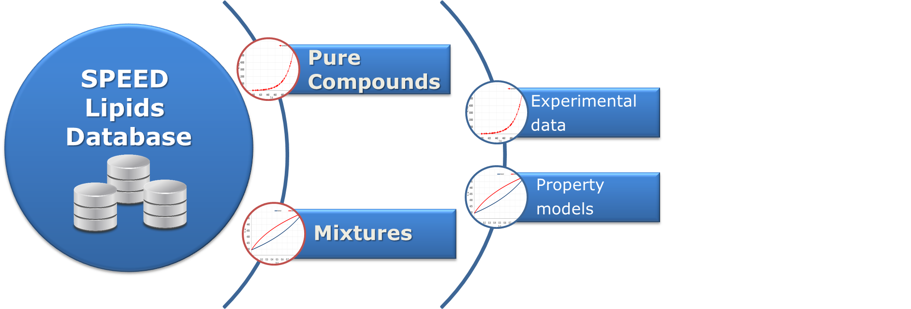
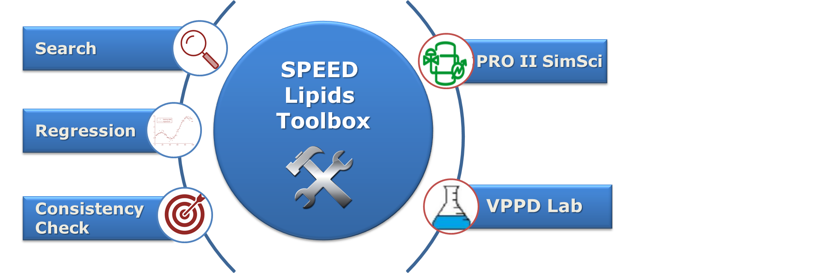
SPEED Lipids Database. Structure & Features
“Thermodynamic needs for the oleochemical industries”, Bent Sarup,
Olivia A. Perederic, Sawitree Kalakul, John M. Woodley, Rafiqul Gani, 16th AIChE Meeting (2016)
Notes:
Database (db) organized in 2 parts, both containing experimental data and property models
Database is connected to Lipids Toolbox which has different features: db search, property models regression, consistency check, database management witch allows the db connection with process and product simulator.
Check presentation – more details on the database

Slide 16
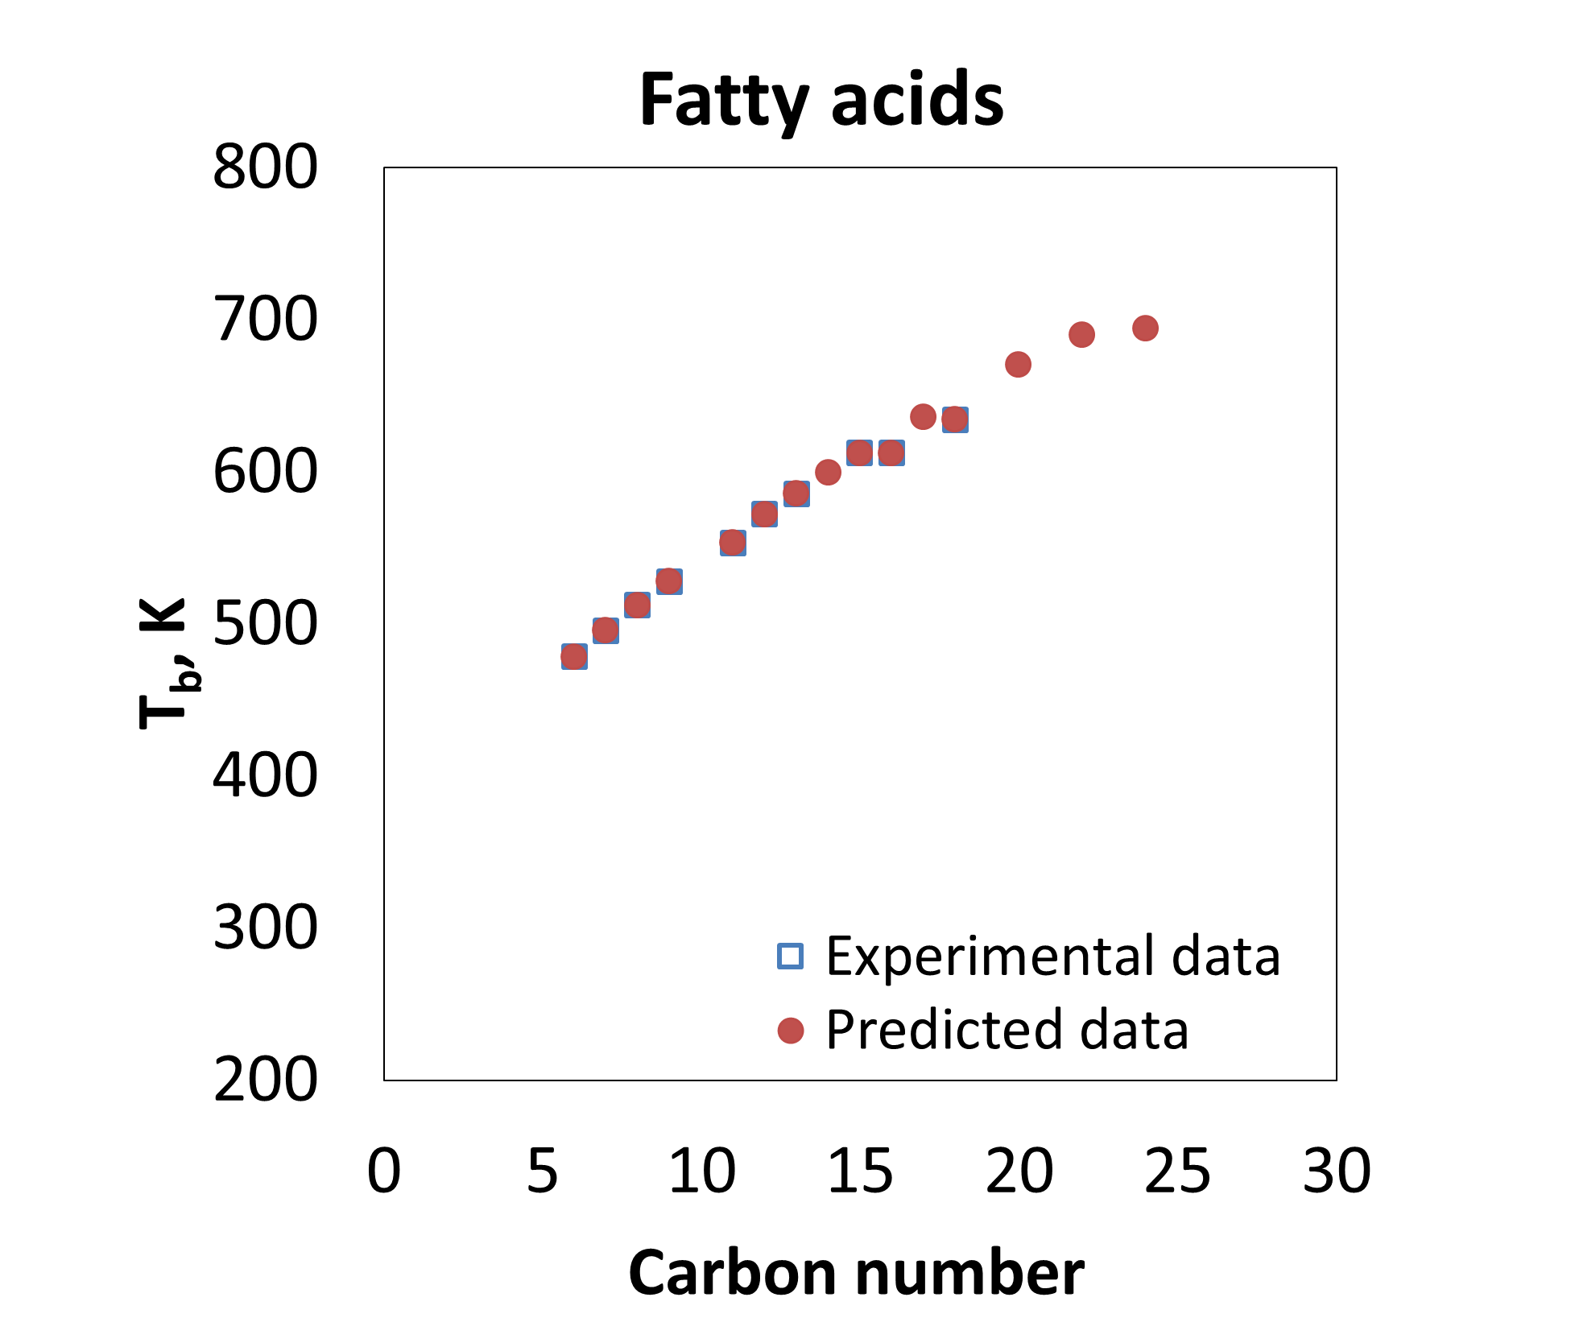
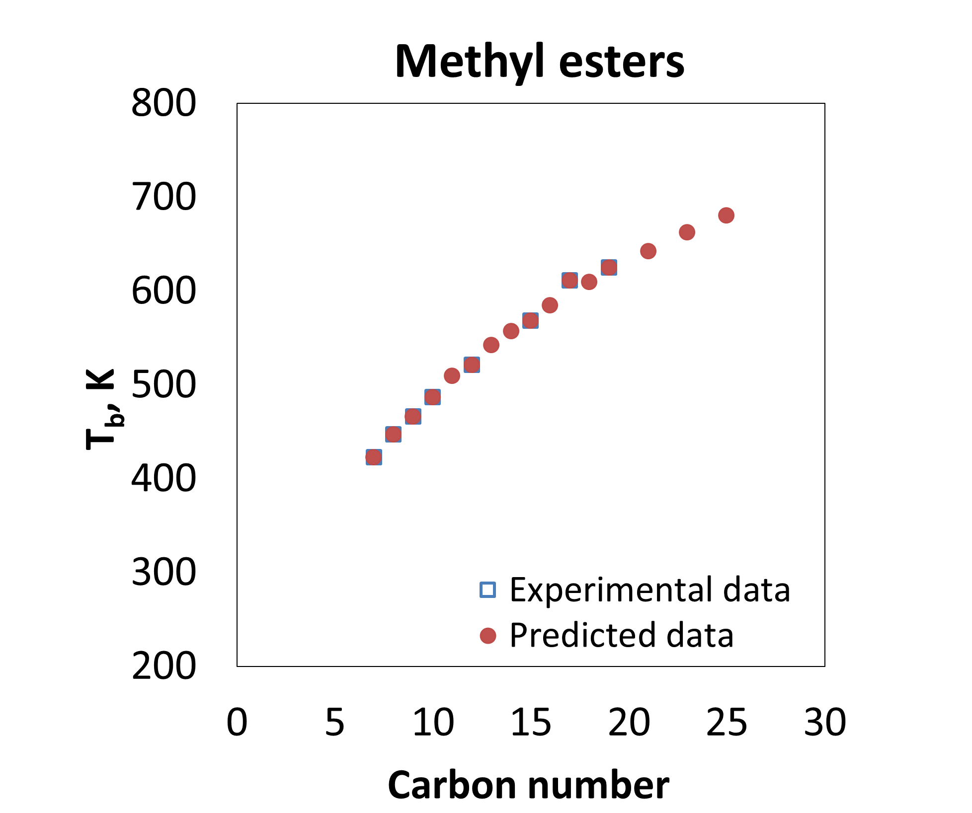
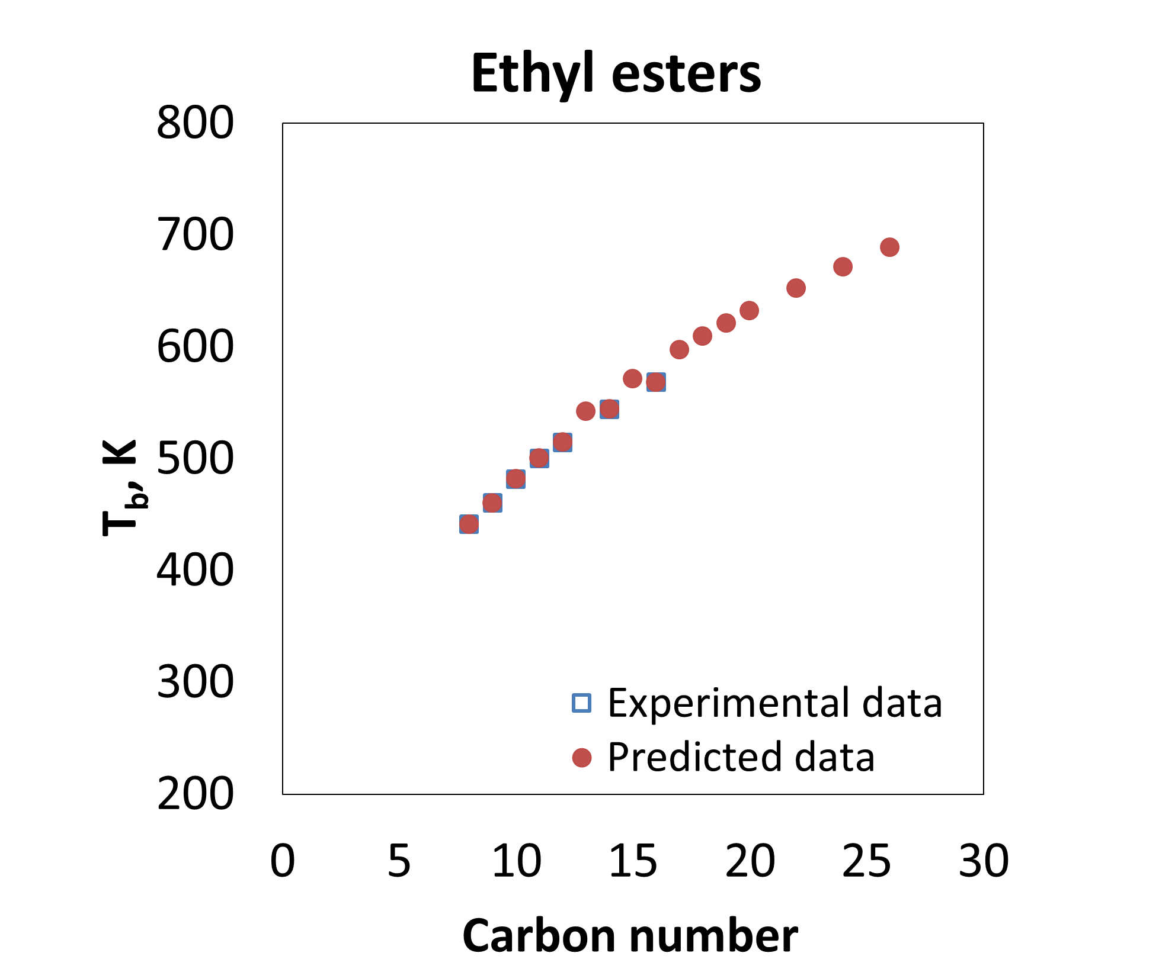
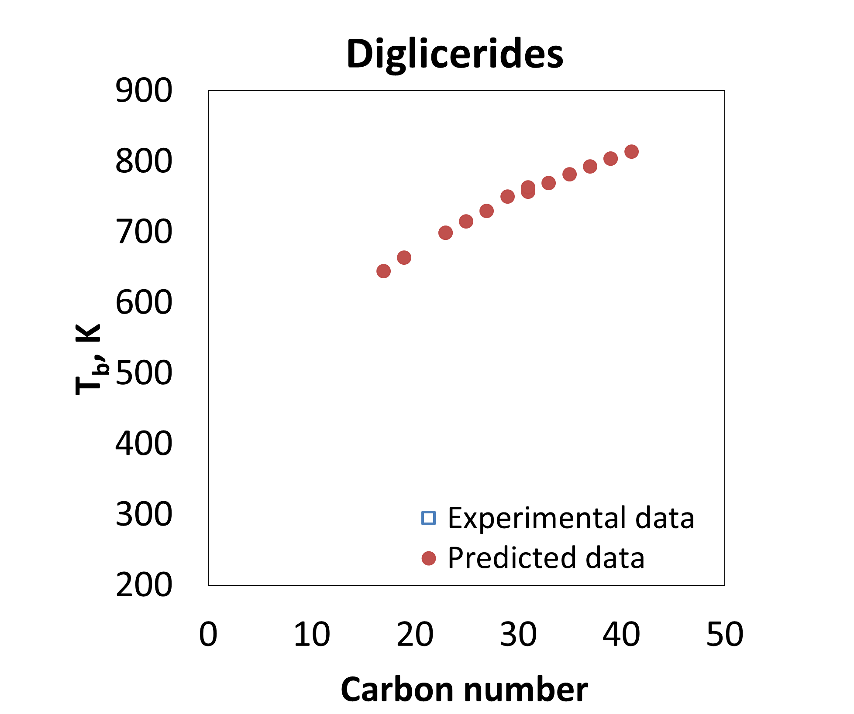
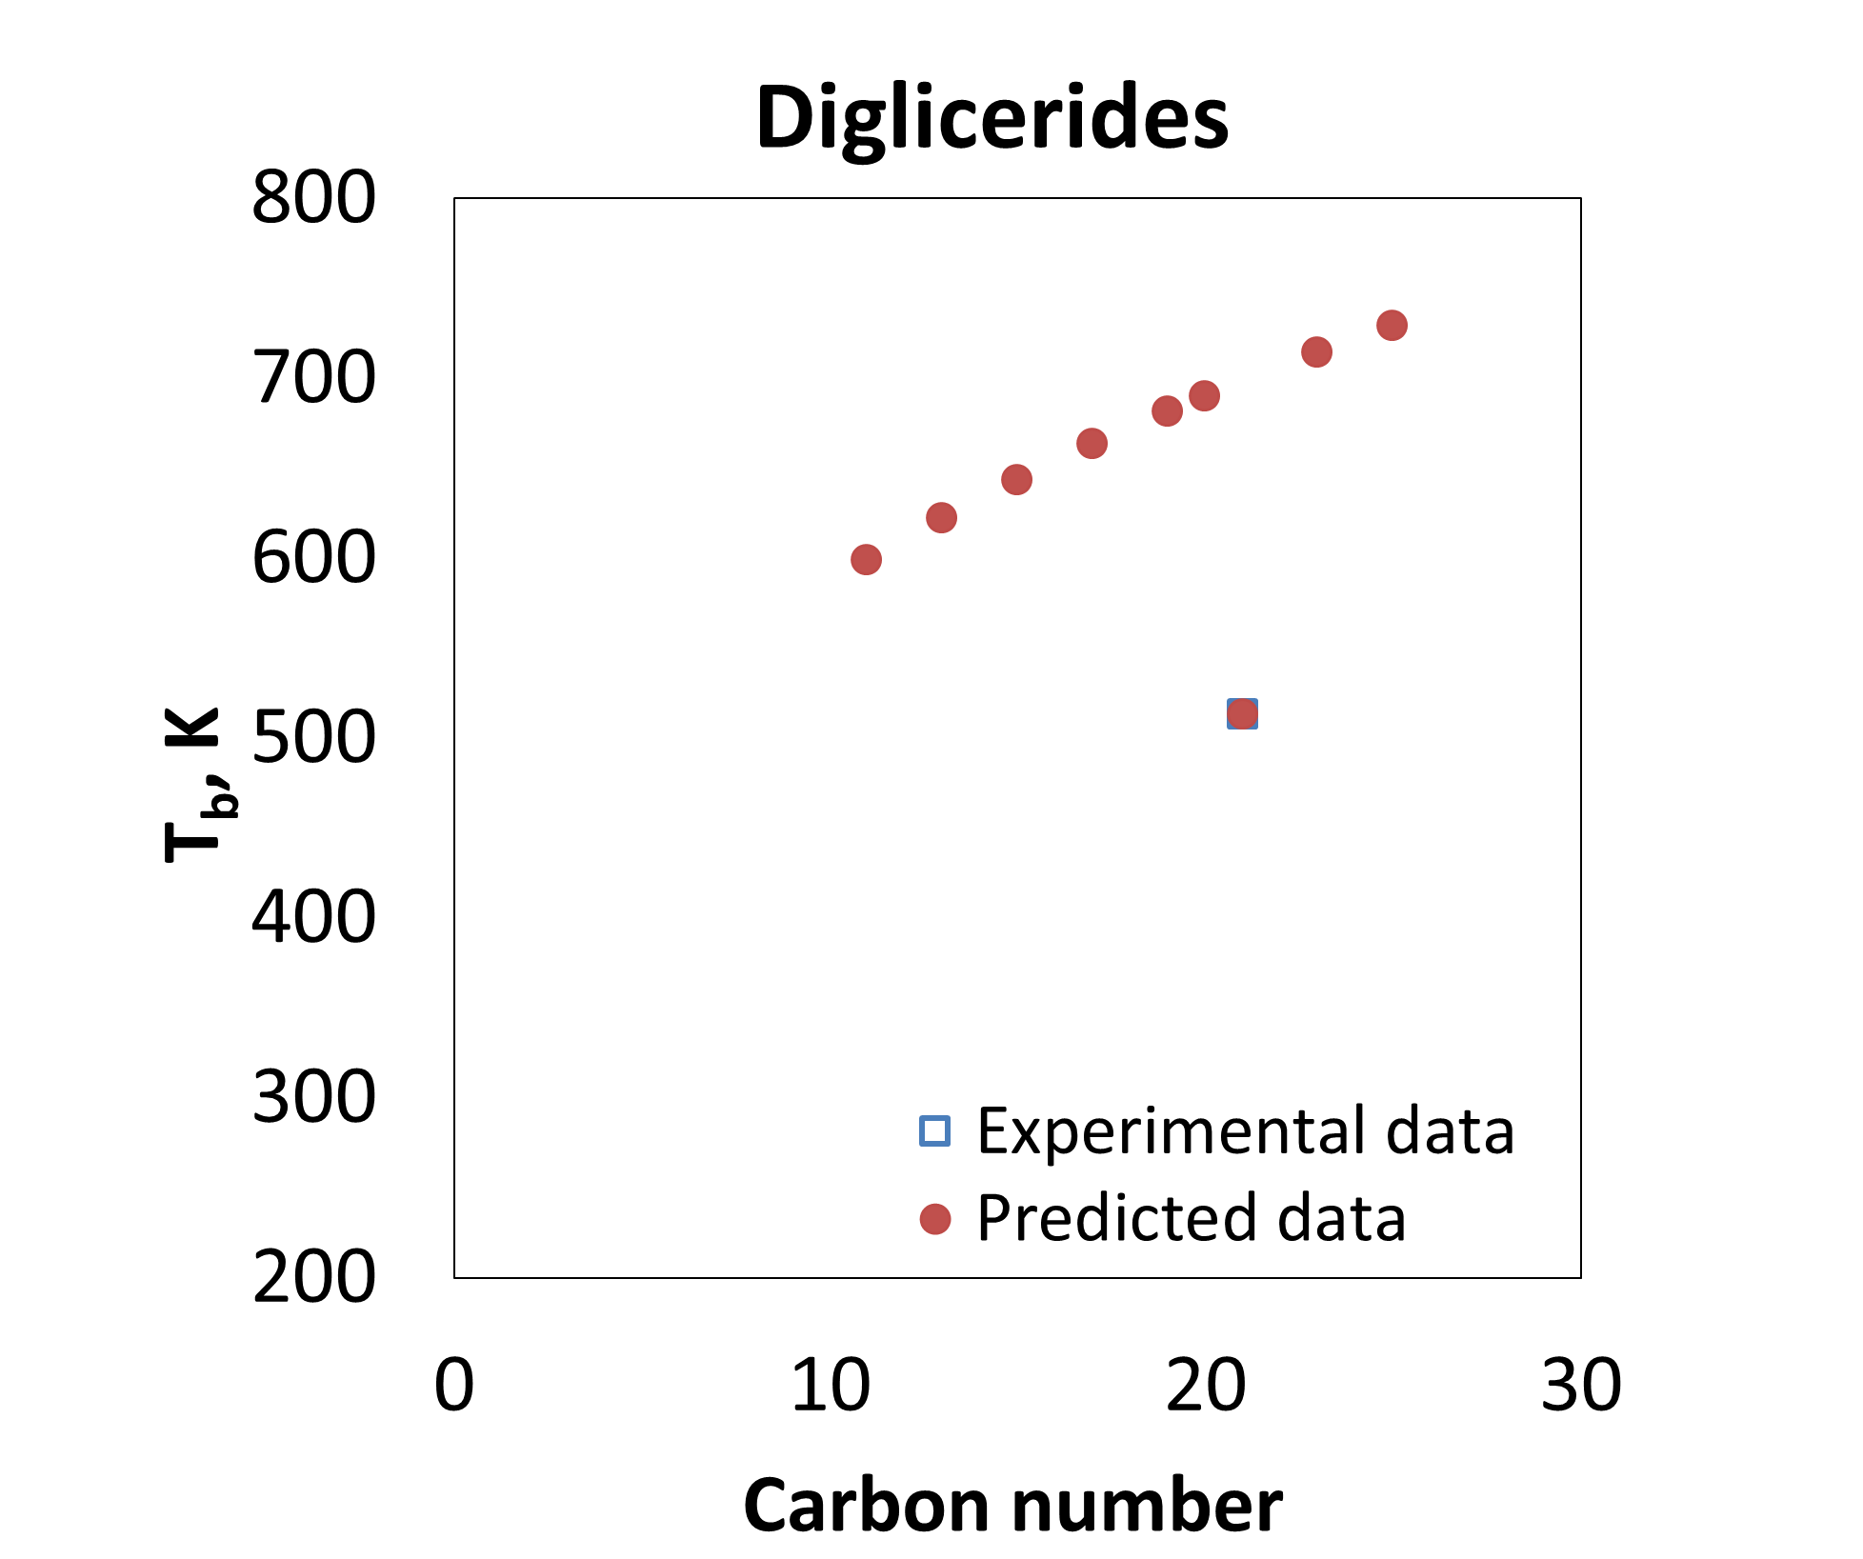
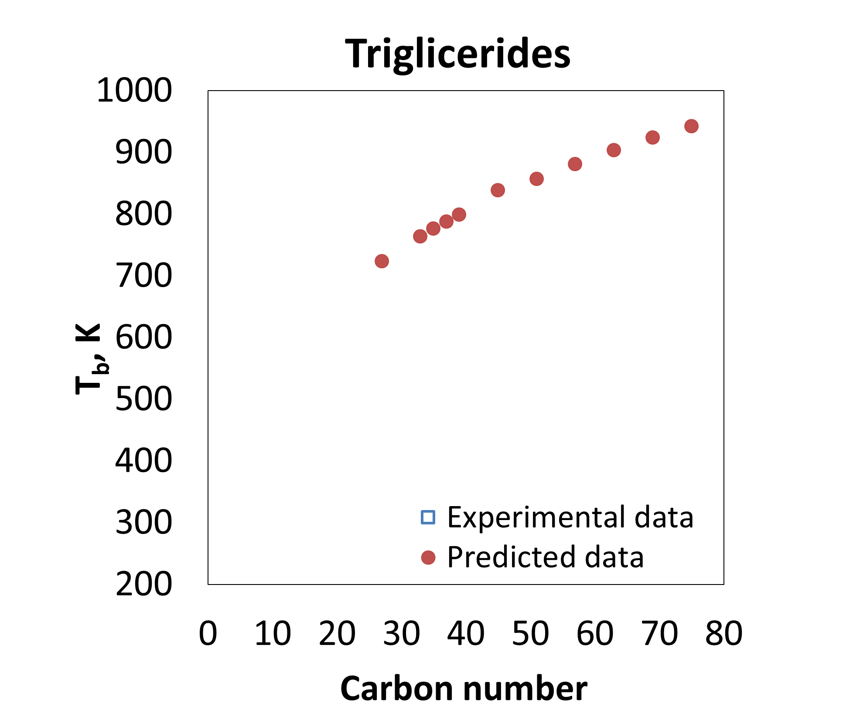
SPEED Lipids Database. Models performances
Pure Compounds
330 compounds
24 property models
Pure compounds properties consistency check
NBP
Triglycerides
Diglycerides
Monoglycerides
“Thermodynamic needs for the oleochemical industries”, Bent Sarup,
Olivia A. Perederic, Sawitree Kalakul, John M. Woodley, Rafiqul Gani, 16th AIChE Meeting (2016)
Notes:
Pure compounds part contains info on 330 compounds for 24 property models (primary and temperature dependent).
DAG: no experimental data, MAG experimental data just for 1 compound

Slide 17
Micronutrient recovery
Deodorizer distillates contain a number of valuable components such as tocopherols, tocotrienols, sterols and squalene, sometimes referred to as volatile “micronutrients”
However, low recovery from the deodorized oil and their concentration in the deodorizer distillates limits the feasibility of further processing of these distillates in dedicated facilities for separation and purification of the micronutrients
It is therefore of considerable interest to improve the understanding of design and operating variables that increase the feasibility of micronutrient utilisation

Slide 18
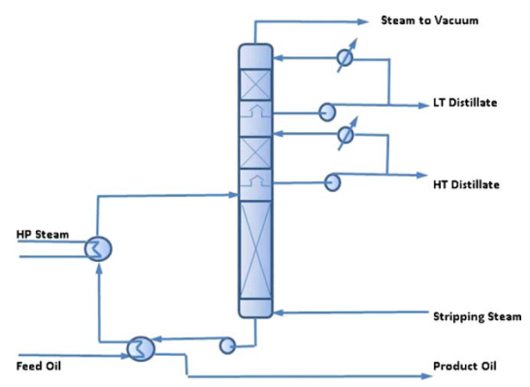
Recovering micronutrients ”Double scrubber”

Slide 19
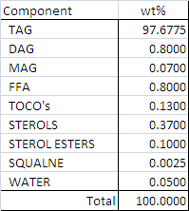
Process simulation example
Oil Soybean oil
Column: Packed (structured packing)
Operating conditions 260 ºC, 0.75% sparge steam, 2.5 mbar vacuum
Oil composition
Simulation model PRO/II with in-house lipid property data base

Slide 20
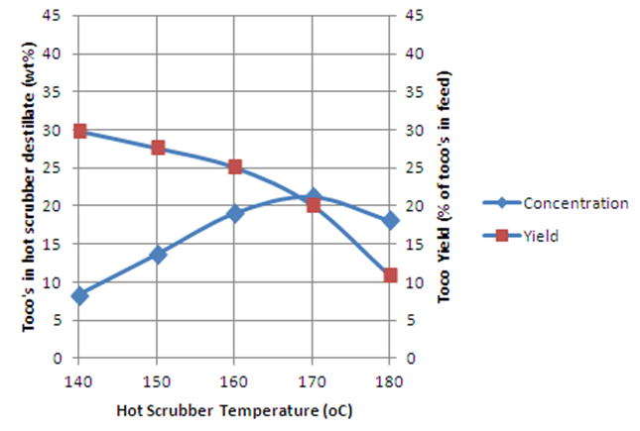
Tocopherols in the hot destillate

Slide 21
”Double Scrubber” Main Characteristics
Optimum operation requires compromising of tocopherol yield and concentration
Relatively narrow range of optimum hot scrubber temperatures
Only stripping and condensation, no rectification functionality
© Alfa Laval
Slide 21
Notes:
© Alfa Laval
21

Slide 22
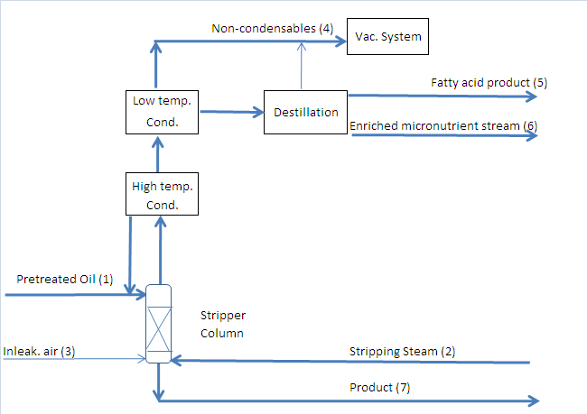
Alfa Laval TocoBoost®
Patents granted and pending (e.g. EP 2597142)

Slide 23
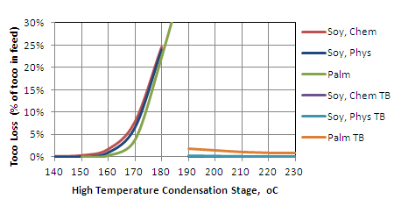
Loss of Toco’s in FFA Product
Double scrubber
TocoBoost®
© Alfa Laval
Slide 23
Patents granted and pending (e.g. EP 2597142)
Notes:
© Alfa Laval
23

Slide 24
Example 2. Supplier collaboration
Enzymatic degumming

Slide 25
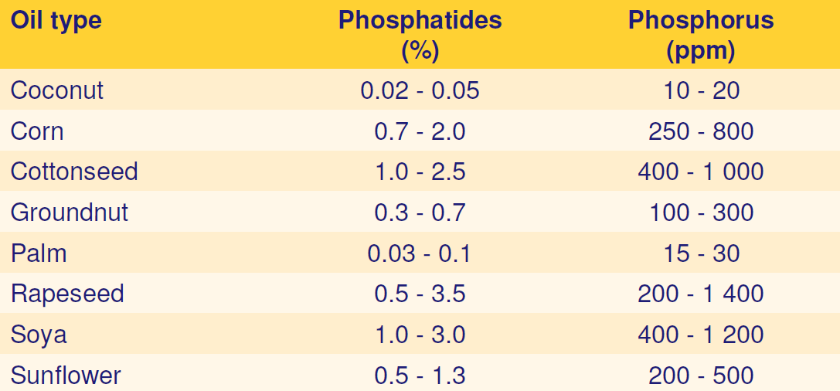
Gum content in crude oils

Slide 26
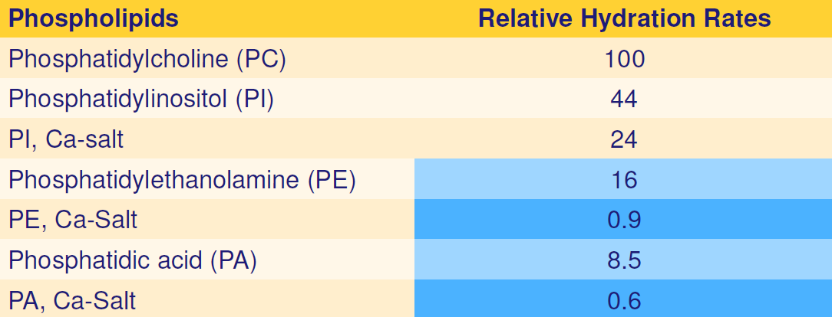
Hydration rates of phosphatides

Slide 27
Phospholipids cause oil loss

Slide 28
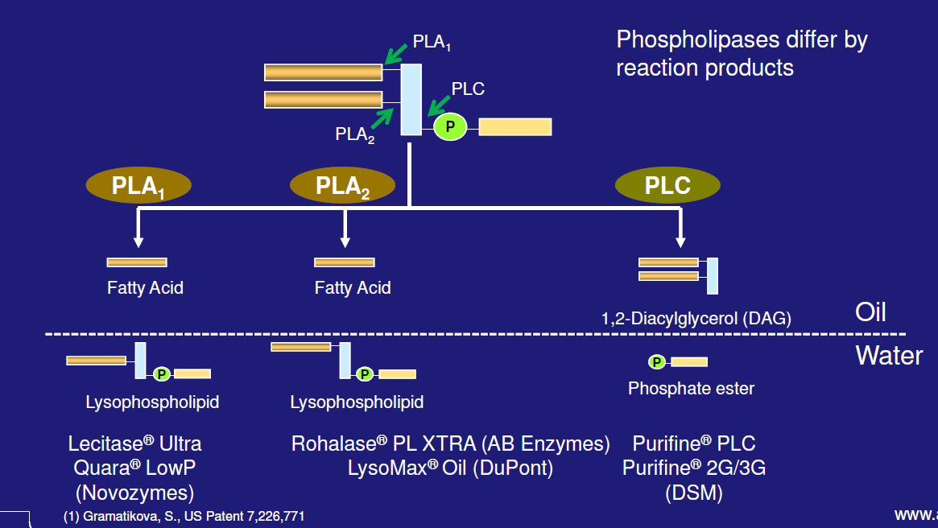
Enzymes reduce degumming yield loss

Slide 29
Enzymatic deep degumming process

Slide 30
Enzymatic refining of water degummed oil
Advantages
no soapstock
no wash water
robust
 | Caustic refining | Enzymatic refining
P level in oil | 150 ppm | 150 ppm
P level after centrifuge | 2 ppm | 2 ppm
Soapstock (%) | 1.51 | 0
Dry lyso gums (%) | 0 | 0.5
Refining loss (%) | 1.42 | 0.45
By-products
lyso-gums
FFA
Ref :Dayton, C., Nov. 2005 Germany

Slide 31
Physical refining plant, enzymatic degumming

Slide 32
Summary
The fats and oils industry is of key importance for food supply as well as a sustainable source of chemicals and liquid fuel.
Technology for the industry continues to undergo change to develop efficiency, minimize losses and provide healthier end products.
A broad collaboration between the customers, edible oil technology suppliers, universities and suppliers is essential to gain speed in process system development.

