Slide 1


Slide 2


Dubai, November the 25th 2017, Keynote Lecture, at:
ICFMCE – International Conference on Functional Materials and Chemical Engineering
AG2S™ technology: the new route for effective CO₂ reuse
Flavio Manenti
CMIC Dept. “Giulia Natta”
Centre for Sustainable Process Engineering Research (SuPER)

Slide 3
CO₂ reuse – Motivation
Anthropogenic CO₂ emissions:
about 33 Gt/y^{[1]}
CO₂ as feedstock
Established processes
CO₂ as feedstock, today
Where and how much?
^{[1]} Le Quéré et al., Earth System Science Data Discussions, 2012, 2015.

Slide 4
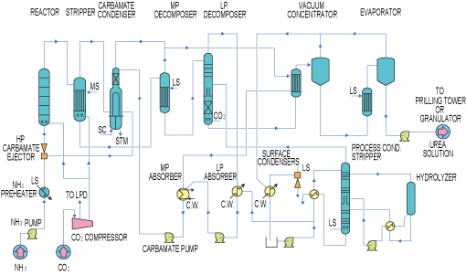
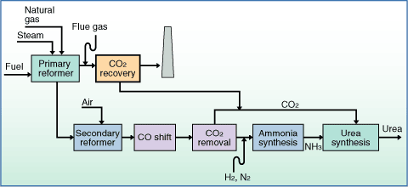
Urea plant
Main use: fertilizer
Plant: large size, downstream the ammonia plant
  Toyo, Casale, Uhde, Stamicarbon, Eni…
Synthesis: 2 NH₃ + CO₂ → (NH₂)₂CO + H₂O
Worldwide CO₂ reuse in urea plants: 187 Mt^{[1]}
[1] Ceresana, Market Study Urea, 2016. ceresana.com
Ref.: http://www.unido.or.jp/en/technology_db/428/
Ref.: https://www.mhi-global.com/products/expand/km-cdr_application_03.html

Slide 5
Methanol plant
Main uses: energy carrier, fuel, base chemical
Perspectives: methanol economy^{[1]}
Plant: large size, downstream the syngas production
  Lurgi, Davy, Toyo, Casale, Air Products, Topsoe…^{[2]}
Synthesis CO + 2 H₂ → CH₃OH; CO₂ + 3 H₂ → CH₃OH + H₂O; WGS
Worldwide CO₂ reuse in MeOH plants: 58 Mt^{[3]}
[3] Petroleum Economist, 2016, petroleum-economist.com
^{[1]} Olah, G. A. (2005). "Beyond Oil and Gas: The Methanol Economy." Angewandte Chemie International Edition 44(18): 2636-2639.
^{[2]} Bozzano, G., Manenti F. (2016). Efficient Methanol synthesis: Perspectives, Technologies and Optimization Strategies, Progress in Energy and Combustion Science, 56, 71–105

Slide 6
Other technologies
Dry reforming
  Pilot-scale
  Synthesis ^{[1]}
    CH₄ + CO₂ → 2 CO + 2 H₂
Sabatier process
  Pilot-scale
  Peak-to-gas
  Synthesis ^{[2]}
    CO₂ + 4 H₂ → CH₄ + 2 H₂O
GTL
  Demo-scale, few large-scale
  Synthesis ^{[3]}
    CO + 2 H₂ → -[CH₂]- + H₂O
    Water Gas Shift (WGS)
^{[1]} Pakhare, D., Spivey, J. (2014), A review of dry (CO2) reforming of methane over noble metal catalysts, Chemical Society Reviews, 43(22), 7813-7837
^{[2]} Che, M., Nobel Prize in chemistry 1912 to Sabatier: Organic chemistry or catalysis? Catalysis Today, 218–219, 162-171, 2013
^{[3]} Pirola, C. et al., Fischer–Tropsch synthesis: EXAFS study of Ru and Pt bimetallic Co based catalysts, Fuel, 132 (2014) 62–70
Current worldwide CO₂ reuse is negligible

Slide 7
What else?
H₂ availability is the key point…
H₂ sources?

Slide 8
Hydrogen (large-scale) production
Industrial scale
  Source:
    methane, naphtha
    steam methane reforming
  Source:
    coal, biomass, urban waste
    gasification
Other proposed molecules
  CH₃OH, NH₃
  H₂O (Power-to-gas)
Renewables
To reuse on-site the CO₂ in the process industry (looping)
We need hydrogen or hydrogen-rich molecules
We need energy

Slide 9
CH₄, CH₃OH, NH₃, H₂O…
… and H₂S?
A natural and synthetic compound

Slide 10

H₂S processing today
Claus process:
    2 H₂S + SO₂ → 1.5 S₂ + 2 H₂O
    H₂S + 1.5 O₂ → SO₂ + H₂O
Claus 1
Claus 2
MP Steam
Comb Air
Thermal Reactor
Acid Gas
LP Steam
WHB
Cond. 1-2
Cond. 3
SWS
Stack / TG
Water
Sulfur

Slide 11
New: Acid gas to Syngas™ technology
Manenti et al., Granted patent WO 2015/015457 A1
New technology (Regenerative Thermal Reactor)
  Overall reaction: 2 H₂S + CO₂ → CO + H₂ + S₂ + H₂O
  3 moles of emissions into 2 moles of syngas
  Energy self-sustainability (minor O₂ injection)
Regenerative sect.
Recuperative sect.
H₂S
CO₂
O₂ (or air)
Steam
CO₂
Effluent
(>1000°C)
Raw Syngas
H₂S
(Acid gas)
Water
Pre-heated Recycle
H₂S, CO₂

Slide 12
Regenerative Thermal Reactor (RTR)
Main effects using RTR^{[1]}
  Good CO₂ and H₂S conversion
  Handling impurities
  Inhibition of side-reactions
O₂ (or air)
Regenerative sect.
Recuperative sect.
H₂S
CO₂
Steam
CO₂
Effluent
(>1000°C)
Raw Syngas
H₂S
(Acid gas)
Water
Pre-heated Recycle
H₂S, CO₂
^{[1]} Manenti et al., Syngas from H2S and CO2: an Alternative, Pioneering Synthesis Route?, Hydrocarbon Processing, 38-41, June 2016

Slide 13
Defeating CO₂ thermal stability
H₂S main role

Slide 14
Reducing radicalic pool

Slide 15
Process scale
Technology layout

Slide 16
AG2S™ complete layout
  2 H₂S + CO₂ → CO + H₂ + S₂ + H₂O
  2 H₂S + SO₂ → 1.5 S₂ + 2 H₂O
  COS + H₂O → CO₂ + H₂S
  CS₂ + 2 H₂O → CO₂ + 2 H₂S
  CO + H₂O ←→ CO₂ + H₂

Slide 17
Main benefits and potential
Complete conversion of H₂S (as per Claus process)
Cut of CO₂ emissions
Reduced use of air or O₂
Production of syngas from two wastes
Exploitation of sulfur-rich resources
  Sulfur-rich coal, shale, oil; H₂S-rich streams of NG, shale gas
  Currently unexploited sources
Production of commodities using CO₂ as feedstock
  Perspective: main process for CO₂ reuse
Reduced investment for revamping
CO₂-free synthesis of base chemicals ( )
  Methanol, (synthetic) fuels, olefins, polymers…
Based on worldwide sulfur production, current potential of AG2S™ is about 44 Mt/y of syngas
Perspective: debottlenecking sulfur-rich sources, AG2S™ potential appears much higher

Slide 18
A case study
Coal gasification

Slide 19
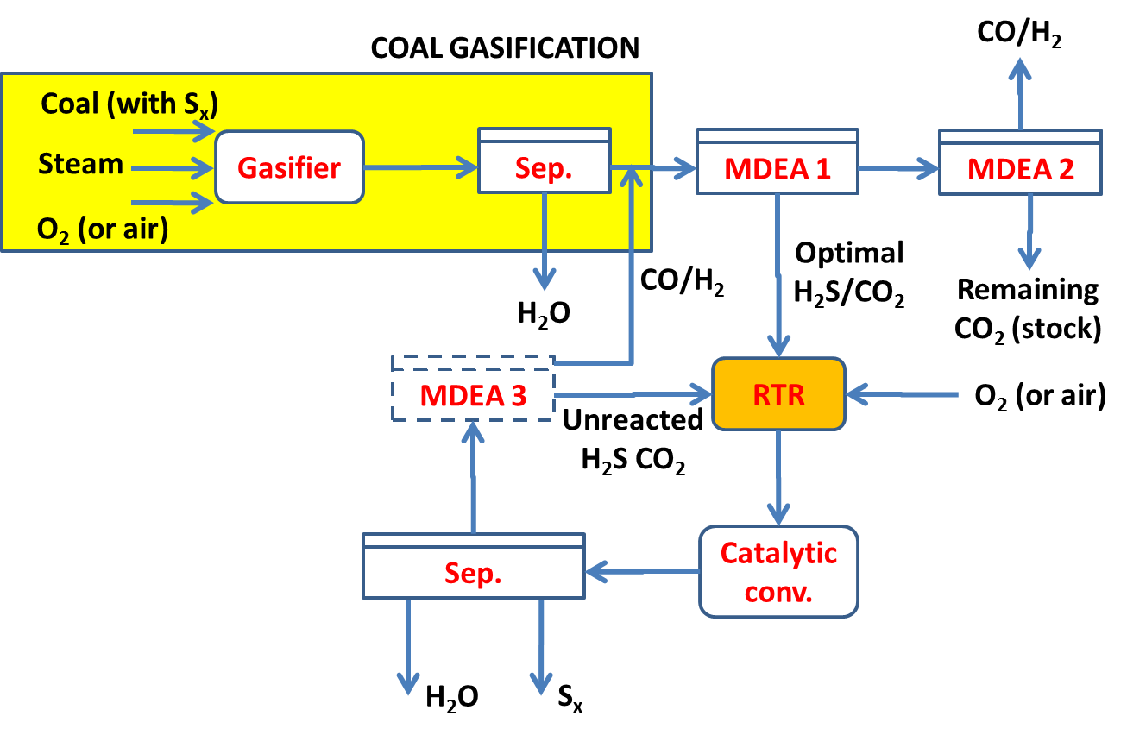
Coal gasification^{[1]}
Use: syngas production
Plant
  large size
  CTX plants
Synthesis
  C + H₂O → CO + H₂
Energy supply
  In situ
  C + O₂ → CO₂
^{[1]} Bassani, A., Acid Gas to Syngas (AG2S™) technology applied to solid fuel gasification: Cutting H2S and CO2 emissions by improving syngas production, Applied Energy, 2016, doi:10.1016/j.apenergy.2016.06.040

Slide 20
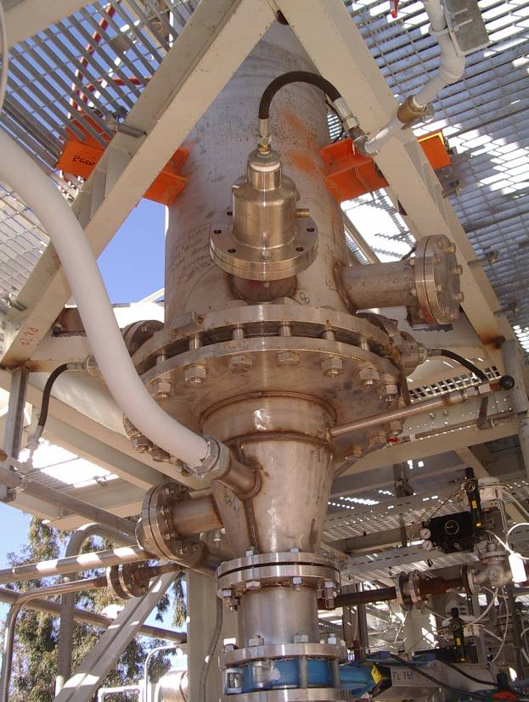

Tools & pilots
Pilots at Sotacarbo facilities
GasDS suite^{[1]} & AspenHysys-PRO/II
GasDS suite
    Chemical kinetics
      Torrefaction, pyrolysis, gasification, combustion
    Reactor configurations
      Updraft, Downdraft, Traveling grate, Fluidized, …
    Design & operational purposes
      Support, Optimization, Validation, Dynamics
      Monitoring, Prediction, Control, Start-up assistant
^{[1]} Ranzi, E., Faravelli, T., Manenti, F., Pyrolysis, Gasification, and Combustion of Solid Fuels, Advances in Chemical Engineering, Elsevier, ISSN 0065-2377, 1-94, 2016.

Slide 21
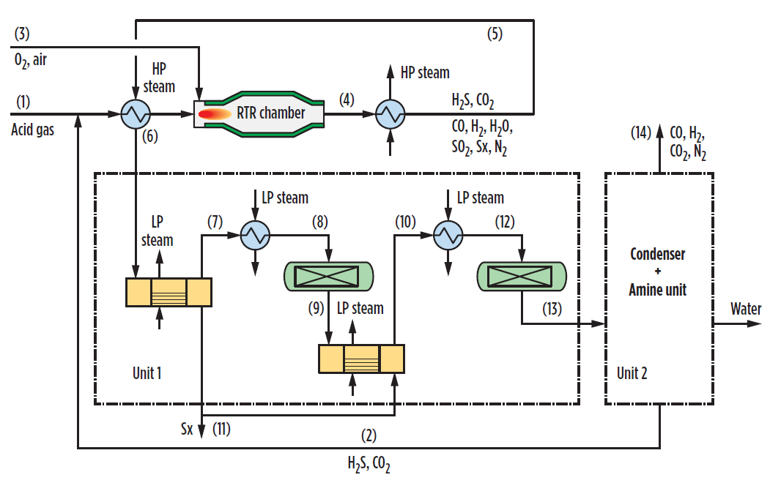
Techno-economic study
Input:
  Coal with 5%w sulfur
  Coal gasifier: 77 t/h
Revamp
  Gas/gas heat exchanger
    49700 kg, 727 k$
  Burner
    165 k$
  Amine washing
    New unit (in spare)
    30 m3/h, 6.16 M$
Payback: 1.63y
  Accounting for syngas only
    Not considered: CO₂ certificates, sulfur, sulfur-rich resources

Slide 22
Technology potential
Application areas

Slide 23
Potential application areas
Coal
Coal gasification
Coke oven gas
Shale
Shale oil
Shale gas
Oil&gas
Natural gas
Crude oil
Heavy oil
Renewables
Biomass/biogas
Geothermal
Hydrogen
Power generation
Hydrotreating
Gasification
Reforming
Fuel
…
Syngas
Ammonia
Synthetic fuels (GTL)
Methanol/DME
Acetic acid
Superior alcohols/ethers/acids
CO
Formylation
Carbonylation
Metals
Metal carbonyls
Acetic acid
Superconductors
Sulfur
Sulfuric acid
Claus
Hydrodesulfurization

Slide 24
Natural gas field
100%v
Let-down
Liquid streams
20%v
Sweetening
30%v
40%v
Total gas streams
Natural gas with 20%v H₂S content
H₂S, CO₂
40%v
Acid gas compression and injection
Energy
10%v
Gas field
H₂S, CO₂
40%v

Slide 25

Natural gas field
100%v
Let-down
Liquid streams
20%v
Sweetening
30%v
52%v
40%v
Total gas streams
Natural gas with 20%v H₂S content
AG2S™ technology
H₂S, CO₂
40%v
10%v
CO₂
Acid gas compression and injection
Energy
10%v
Sulfur, water
15%v
3%v
AG2S™ IS HIGHER-PERFROMANCE GAS FIELD
Gas field
H₂S, CO₂
40%v
More gas production
Less energy consumption
Longer drill life (no H₂S re-injection)
CO₂
10%v

Slide 26
Oil shale
100%v
Retorting
Energy
5%v
Refining
Products
20%v
By-products
5%v
Raw oil shale
(acid gases)
Exhaust oil shale
70%v
Oil shale deposit

Slide 27
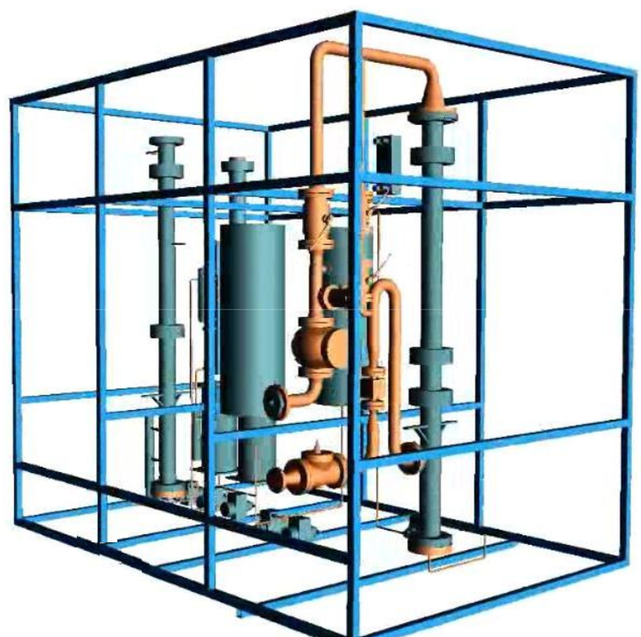
Oil shale
100%v
Retorting
AG2S™ IS SHALE OIL BOOSTER
Reduced environmental impact
Higher production yield
Better shale exploitation
Portability
Energy
5%v
5%v
Refining
Products
20%v
25%v
By-products
5%v
Raw oil shale
(acid gases)
70%v
AG2S™ technology
Sulfur
Water
Exhaust oil shale
5%v
70%v
Oil shale deposit
65%v
Compact, portable module

Slide 28
Oil refining – HDS/Reforming
Flue gases
165%v
CO₂
100%v
100%v
Steam reforming
WGSR
PSA
Steam
100%v
Naphtha
H₂
400%v
15%v
Combustion air
Oil with sulfur
HDS
Oil
150%v
H₂S
400%v

Slide 29
Oil refining – HDS/Reforming
Flue gases
50%v
165%v
88%v
CO₂
50%v
100%v
100%v
Steam reforming
WGSR
PSA
Steam
100%v
Naphtha
50%v
H₂
400%v
15%v
Combution air
Oil with sulfur
HDS
Oil
8%v
150%v
80%v
H₂, CO
H₂S
400%v
200%v
AG2S™ IS HYDROGEN RECOVERY
Less flue gas/CO₂ environmental impact
Internal hydrogen loop
Reduced reforming duty
Better naphtha potential exploitation
AG2S™ technology
Sulfur, water
200%v

Slide 30
CO2-free coal-to-methanol process
O₂ or air
Coal gasifier
Steam
Coal with 20% sulfur content
Ash
100%v
Dewatering
H₂O
Sweetening
40%v
H₂S, CO₂
Synthesis
MeOH
60%v

Slide 31
CO2-free coal-to-methanol process
O₂ or air
Coal gasifier
Steam
AG2S™ IS GREENER COAL USES
Less (no) CO₂ environmental impact
More syngas production
Less coal uses with same production
Better coal potential exploitation
Coal with 20% sulfur content
Ash
100%v
Dewatering
H₂O
10%v
Sweetening
40%v
AG2S™ technology
Market sulfur
Water
Remaining CO₂
H₂S, CO₂
10%v
Synthesis
MeOH
MeOH surplus
60%v
20%v

Slide 32
Conclusions
We are preventing CO₂ formation
Thanks to renewables
We are capturing CO₂ by pre-/post-combustion CCS technologies
We are not yet reusing CO₂ as in our possibilities
Just less than 1% is currently reused
AG2S™ will allow to cut reuse several percents
After H2020, a large program on CO₂ reuse (CCU) will be launched in EC
Atmospheric CO₂ / emissions will unavoidably be the future carbon source for chemistry, chemical & process engineering

Slide 33





Acknowledgements

Slide 34
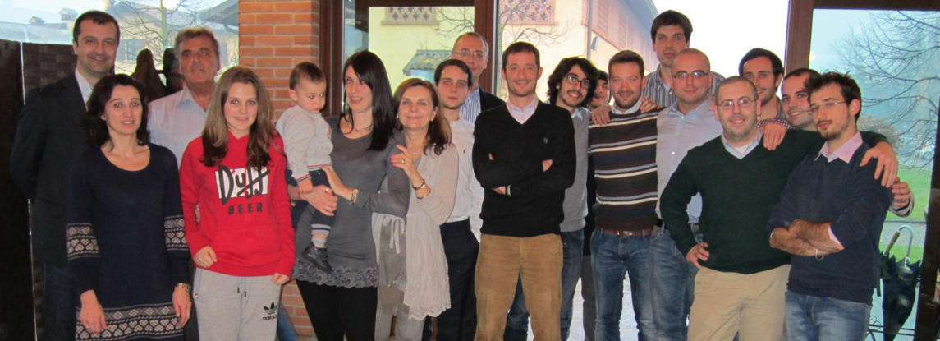





Thanks for the kind attention
Flavio Manenti
Professor of Chemical Plants and Operations
Executive Board of EFCE, AIDIC, CAPE-WP, AIAC
POLITECNICO DI MILANO
Dipartimento di Chimica, Materiali e Ingegneria Chimica "G. Natta"
Sustainable Process Engineering Research (SuPER) team
Piazza Leonardo da Vinci, 32, 20133 Milano, ITALY
TECHNISCHE UNIVERSITAT BERLIN
Alexander von Humboldt Professor
DBTA (Dynamic und Betrieb Technischer Anlagen) Faculty
Sekt. KWT 9, Strasse des 17.Juni, 135 - D-10623 Berlin, GERMANY
(Mobile) +39.338.5665817
(Phone) +39.(0)2.2399.3273 - +49.(0)30.314.23418
(Email) flavio.manenti@polimi.it
WELCOME… - (Web) http://super.chem.polimi.it

Slide 35

Flavio Manenti, flavio.manenti@polimi.it

