Slide 1
The ‘ideal’ selectivity vs ‘true ’ selectivity for permeation of gas mixtures in a nanoporous membrane
Presenter: Zhou He^{1,2}
Supervisor: Prof. Kean WANG¹
1-Department of Chemical Engineering, Khalifa University of Science & Technology
2-China University of Petroleum (East China)

Slide 2
01
Introduction
02
Experimental
03
Results and Discussions
CONTENTS
04
Conclusions
05
Acknowledgement

Slide 3
The First Part
Introduction
We are pursuing the best!

Slide 4
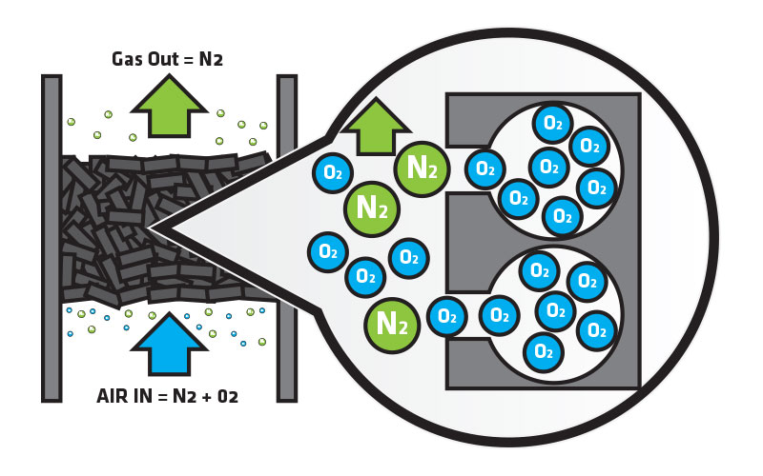
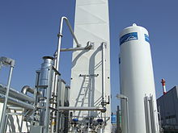
Conventional process for Gas separation
Pressure Swing Adsorption
Drawbacks
Separating the gas specie from a mixture under specific pressure based on specie’s molecular adsorption affinity with an adsorbent material, such as zeolite and activated carbon.
Extreme high pressure operation
High energy consumption
Difficult to regenerate
Cryogenic Separation
Drawbacks
Pure gases can be separated from air by first cooling it until it liquefies, then selectively distilling the components at their various boiling temperatures.
Complicate trays in column
High cost
Energy intensive
Critical operating environment
Z. Y. Yeo, T. L. Chew, P. W. Zhu, A. R. Mohamed, and S. P. Chai, "Conventional processes and membrane technology for carbon dioxide removal from natural gas: A review," Journal of Natural Gas Chemistry, vol. 21, pp. 282-298, May 2012.

Slide 5
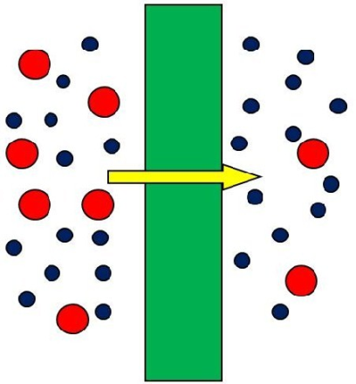
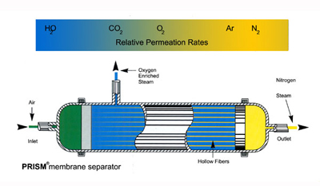
Membrane Technology for Gas Separation
Molecular size, mass, polarization, adsorption etc.
Energy and space efficient
Easy to scale up
Low cost and maintenance
Recyclable and environmentally friendly
Simple in mechanism

Slide 6
Issues
Ideal selectivity?
Q
Most publications evaluated the separation performance of a membrane according to the ‘ideal’ selectivity of a gas pair, which is calculated as the ratio of Permeabilities of each pure component.
Issues: Ignore mutual interaction for gas species in binary mixture through membrane, which can be wrong especially for the candidates with greatly different property.
Solutions: We need to find a effective tool to research ‘true’ selectivity of gas mixture permeation for better development of membrane technology
C
Experimental technology for ‘true’ selectivity?
Diffusion cell (Wicke-Kallenbach) technique is capable of measuring the binary gas permeation by GC/MS analyzer.
Issues: a ‘sweeping gas’ (normally helium) used to carry permeates to a GC/MS will induce the back-diffusion from downstream across the membrane. According to Maxwell-Stefan theory, the interaction between the sweeping gas molecules (which is virtually the 3rd component) and the permeating gas molecules will affect the permeation behaviors of the binary system
Q

Slide 7
A novel technique
A novel technique to measure the permeation of binary gas mixture
To overcome above defects, this research employs a cold trap (with liquid N₂) to the downstream of a conventional time lag rig to condense one species into solid phase while keeping the other species in gas phase, as shown in Table 1.
Advantages: 1) minimal modification of the old rig; 2) ‘true’ permeation behavior can be revealed; 3) no interference of sweeping gas; 4) non-destructive; 5) cheap and easy to achieve.
Species | H_{e} | H₂ | CO₂ | CH₄ | N₂ | C₂H₆ | H₂O
Boiling point (K) | 4.20 | 20.25 | 194.50† | 90.65 | 77.36 | 184.20 | 373.15
LJ diameter (Å) | 2.60 | 2.89 | 3.30 | 3.80 | 3.64 | 4.43 | 2.65
State @ 77K Vapor pressure @ 77K (kPa) | Gas - | Gas - | Solid 1.20×10⁻⁹ | Solid 1.17 | Gas 101.32 | Solid 2.40×10⁻⁵ | Solid ~0
Table 1: Molecular properties of some popular gases/vapors.

Slide 8
The Second Part
Experimental
We are pursuing the best!

Slide 9
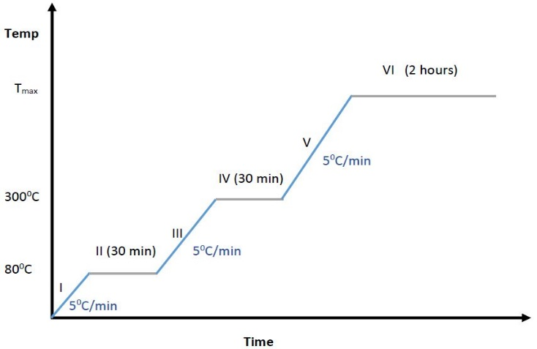
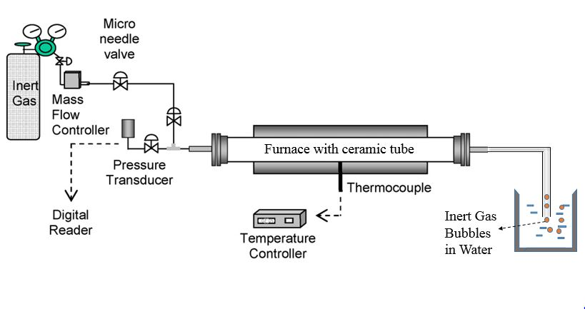
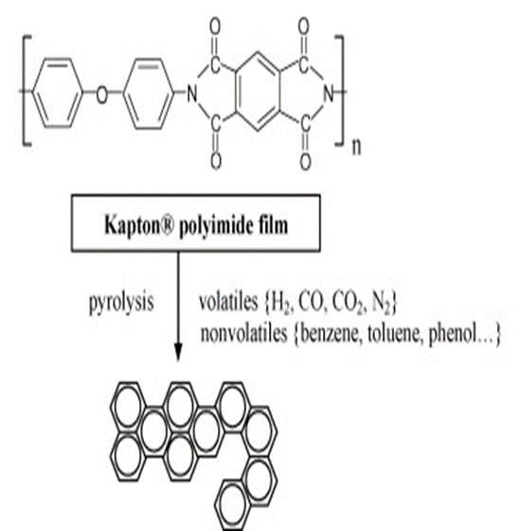
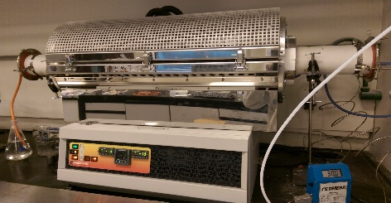
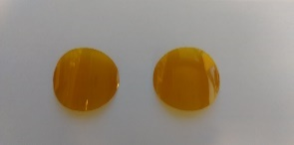
Membrane Synthesis
Carbon Molecular Sieve Membrane (CMSM)
Polyimide Precursor for CMSM700
Polyimide gives good carbon membranes in terms of both separation and mechanical properties.
Polyimide film of 20 mm in diameter .
Pyrolysis in tube Furnace with a flowrate of inert Nitrogen gas at 50 ml/min.
Three heating zones controlled by Multi channel controller.
Highest temperature is 700$℃$
CMSM density is 3.04g/cc with a thickness of 44um
Figure 1: Schematic diagram of pyrolysis rig & protocol

Slide 10
Pure Gas Permeation Measurement
Down stream Pressure
- Traditional Time Lag rig
- CO₂/He/H₂
Slope =S₀
Pressure Transducer
Membrane
Cell
P
P
Time
Time Lag, t_{L}
Steady state flux
$$J=\frac{V_{r}}{RT∗A_{m}}\frac{dp}{dt}$$
Upstream Vessels
Downstream Vessels
Turbo Pump,
10⁻⁴ Torr
Time lag
Gas
Cylinder
L$=\frac{l^{2}}{6∗D}$
Figure 2: Schematic diagram of a gas permeation rig
Notes:
The separation performance of a CM can be measured by a permeation rig.
The membrane is in the membrane cell at the middle. The upstream vessels are charged with permeation gas, its volume is large ~ few liters. The downstream vessel is evacuated to very low pressure , how low ? ~ 10⁻⁴ Torr.
When we switch on the gas, the down stream pressure will increase, which is closely monitored by the pressure transducer. This pressure response is not arbitrary, but follows certain pattern. In a short period of time, it will reach the quasi-steady state, with the constant gradient of S0. This straight line has a intercept of t_{L} on time coordinate, which is called the time lag. The slope, as we see, is related to the flux or permeability of the membrane; the time lag relates to the diffusivity. So these two important parameters of the membrane can be measured at the same time.

Slide 11
Binary Permeation Test
- a novel technique
- CO₂-He/CO₂-H₂ system
Experimental steps (e.g., CO₂:H₂ =1:1, P_{total} = 2 bar):
Charge H₂ (2bar) into C1 and then isolated by turning off V5.
Charge CO₂ (2bar) into C2 and then isolated by turning off V6.
V5-V7 were opened to connect C1 and C2 in an open loop. A hot air gun slightly heat up the middle of C1 to ~ 60°C while keeping C2 at the room temperature (~25°C). This will generate the forced convection in the loop to assist the mixing.
The heating/mixing was stopped after 2 hours and the system was allowed to cool down to room temperature.
The cold trap was applied at the U-shaped pipeline. The fan was turned on.
Open the V3 to start the binary gas permeation.
Figure 3: Schematic diagram of improved time lag rig

Slide 12
The Third Part
Results and Discussions
We are pursuing the best!

Slide 13
Characterizing experiments
$$Pe=\frac{J}{∆P}l$$
$$Pe=D×S$$
Table 2. Properties of pure gas permeation measurement (permeability Pe, diffusivity D and sorptivity S) at 25℃, 1atm in CMSM700.
Gases | He | H₂ | CO₂
Pe (barrer) | 143.00 | 340.00 | 45.80
Time lag (s) | 1.30 | 2.78 | 1160
D (cm²/s) | 2.50$×$10⁻⁶ | 1.16$×$10⁻⁶ | 2.78$×$10⁻⁹
S (cmHg⁻¹) | 5.72$×$10⁻³ | 2.93$×$10⁻² | 1.65
Apparent Diffusivity: D(He) > D(H₂) >> D(CO₂)
Apparent Sorptivity: S(CO₂) >> S(H₂) > S(He)
CO₂: slow-diffusing strongly adsorbing gas
H₂: fast-diffusing weakly adsorbing gas
H_{e}: fast-diffusing non-adsorbing gas (ref.)
H. Suda and K. Haraya, "Gas permeation through micropores of carbon molecular sieve membranes derived from Kapton polyimide," Journal of Physical Chemistry B, vol. 101, pp. 3988-3994, May 1997.

Slide 14
Permeation of Binary gas mixtures
CO₂-He & CO₂-H₂
Get the binary flux $J_{t}.$
In the following stage, the cold trap was applied and removed twice at certain time interval to double check the assumption of the (quasi-) steady state.
At t=2480s, remove the cold trap
Add the cold tarp at the beginning, the response only shows the non-condensed specie (H_{e}/H₂)
(Quasi-)Steady state achieved,
Get the non-condensed component’s flux $J_{1}$
Flux of component 2: $J_{2}=J_{t}−J_{1}$

Slide 15
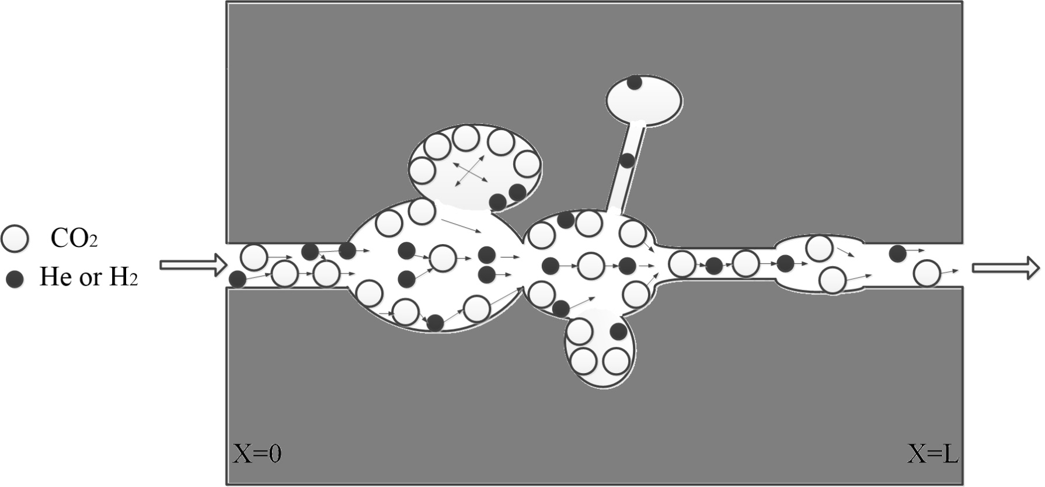
Transport process @ Adsorption-Diffusion
Binary Langmuir Isotherm
$$q_{1}=q_{m1}\frac{b_{1}P_{1}}{1+b_{1}P_{1}+b_{2}P_{2}}$$
$$q_{2}=q_{m2}\frac{b_{1}P_{2}}{1+b_{1}P_{1}+b_{2}P_{2}}$$
Dead end
Competitive adsorption, is negative for both species, but more significant for He/H₂ (b₁>>b₂) .
Through pore
Maxwell-Stefan equation
Exchange coefficient: it describes the molecular collision between gas molecules, which can result in a speeding-up effect on heavy specie CO₂ and a slowing-sown effect on light specie.
It is positive for CO₂ diffusion and negative for He/H₂ diffusion
$$\left[\begin{matrix}\frac{1}{Ð_{1}}+\frac{x_{2}}{Ð_{12}} & −\frac{x_{1}}{Ð_{12}} \\ −\frac{x_{2}}{Ð_{12}} & \frac{1}{Ð_{2}}+\frac{x_{1}}{Ð_{12}}\end{matrix}\right]∙\left[\begin{matrix}J_{1} \\ J_{2}\end{matrix}\right]=\left[\begin{matrix}−\frac{q_{1}}{RT}∇μ_{1} \\ −\frac{q_{2}}{RT}∇μ_{2}\end{matrix}\right]$$
R. Krishna and J. M. van Baten, "Maxwell–Stefan modeling of slowing-down effects in mixed gas permeation across porous membranes," Journal of Membrane Science, vol. 383, pp. 289-300, 11/1/ 2011.

Slide 16
Permeabilities & Selectivities
$$α_{ij}=\frac{\left.Pe(i\right)}{\left.Pe(j\right)}$$
$$P_{r}=\frac{Pe}{{Pe}^{∗}}$$
Table 3. Comparison of the ‘True’ and ‘Ideal’ permeation selectivities of CO₂/He & CO₂/H₂
Binary gas mixtures |  | $P_{e}^{T}$ (barrer) | $$P_{e}^{I}$$ (barrer) | P_{r} | $$α_{2/1}^{T}$$ | $$α_{2/1}^{I}$$
#A | CO₂ 1bar H_{e} 1bar | 31.00 50.70 | 45.80 144.00 | 0.677 0.352 | 1.64 | 3.14
#B | CO₂ 2bar H_{e} 1bar | 32.00 30.00 | 43.00 144.00 | 0.744 0.208 | 0.94 | 3.35
#C | CO₂ 3bar H_{e} 1bar | 36.00 17.50 | 40.20 144.00 | 0.896 0.122 | 0.49 | 3.58
#D | CO₂ 2bar H₂ 0.5bar | 39.50 44.01 | 43.00 340.00 | 0.919 0.129 | 1.11 | 7.91
Note: P_{e}^{I} : Permeability of pure gas at the same (partial) permeation pressure. 1- CO₂; 2 – He or H₂.
H_{e} selective
CO₂ selective

Slide 17
Conclusions
Our purposed novel time lag technology had been validated effectively to be applied for measuring binary gas permeation.
For the development of membrane technology, the ‘true’ selectivity should be considered due to the significant departure of ‘ideal’ selectivity from true values based on tests of CO₂-H_{e} & CO₂-H₂ system. The ‘ideal’ selectivity can be very misleading when used to evaluate a membrane separation performance.
Competitive adsorption and diffusion have a significant impact on permeation process in CMSM of both gas components but more significantly for light species.
This research laid solid fundamental for development in membrane gas separation.

Slide 18
Acknowledgements/Thank you/ Q&A?
We would like to acknowledge the funding from Gas Research Centre (Project code: GRC010, Fund code: 11810/11010) & Abu Dhabi National Oil Company (ADNOC).
Presenter: Zhou He^{1,2}
Supervisor: Prof. Kean WANG¹
1-Department of Chemical Engineering, Khalifa University of Science & Technology
2-China University of Petroleum (East China)

